Slide 1
Bezier Curves
Invented and named after French engineer, Pierre Bezier in 1970s
To allow his firm’s computers to describe the shape of car bodies
Actual study started in 1959 by a mathematician named Paul De Casteljau
Invented a stable mathematical model known as De Casteljau’s algorithm

Slide 2
Properties
The curve begins at P₀ and ends at P_{n}; this is the so-called endpoint interpolation property
The Bezier curve only approximates the control points
Control points connects to each other
Doesn’t actually pass through all of them
The curve is a straight line if and only if all the control points are collinear

Slide 3
Properties
A curve can be split at any point into two subcurves, or into arbitrarily many subcurves, each of which is also a Bézier curve
Some curves that seem simple, such as the circle, cannot be described exactly by a Bézier or piecewise Bézier curve; though a four-piece cubic Bézier curve can approximate a circle
Every quadratic Bézier curve is also a cubic Bézier curve, and more generally, every degree n Bézier curve is also a degree m curve for any m > n

Slide 4
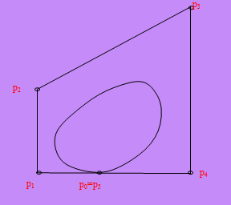
Design Technique using Bezier Curves
A closed Bezier curve can be generated by specifying the first and last control points at the same location

Slide 5
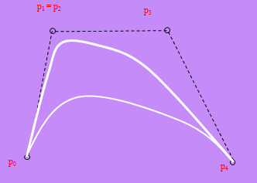
Design Technique using Bezier Curves
A Bezier curve can be made to pass closer to a given coordinate position by assigning multiple control points to that position.

Slide 6
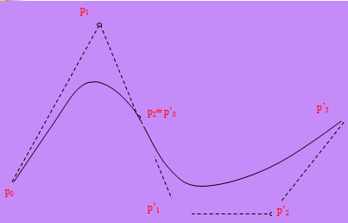
Design Technique using Bezier Curves
Bezier curve can be form by piecing of several Bezier section with lower degree.

Slide 7
Types of Bezier curves
Linear Bezier Curve
Quadratic Bezier Curve
Cubic Bezier Curve
Highet Order Bezier Curve

Slide 8


Constructing Linear Bezier Curve
If P₀ and P₁
are (x0,y0) and (x1,y1) the linear interpolant is
the straight line between these points. For a value x in the interval (x0,x1) , the value y along the straight line is given from the equation

Slide 9
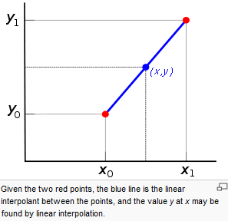
Constructing Linear Bezier Curve

Slide 10
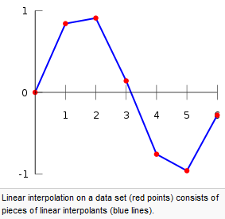
Interpolation of a data set
Linear interpolation on a set of data points (x₀, y₀), (x₁, y₁), ..., (x_{n}, y_{n}) is defined as the concatenation of linear interpolants between each pair of data points

Slide 11
Linear curves
A linear Bézier curve is simply a straight line between those two points such as P₀ and P₁
The t in the function for a linear Bézier curve can be thought of as how far B(t) is from P₀ to P₁.
For example when t=0.25, B(t) is one quarter of the way from point P₀ to P₁.
As t varies from 0 to 1, B(t) describes a straight line from P₀ to P₁.

Slide 12
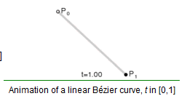
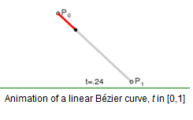
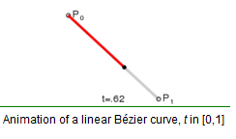
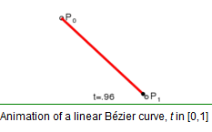
Linear curves

Slide 13
Quadratic Bézier curves
A quadratic Bézier curve is the path traced by the function B(t), given points P₀, P₁, and P₂
Which can be interpreted as the linear interpolant of corresponding points on the linear Bézier curves from P₀ to P₁ and from P₁ to P₂ respectively
It can be concluded that the tangents to the curve at P₀ and P₂ intersect at P₁. As t increases from 0 to 1, the curve departs from P₀ in the direction of P₁, then bends to arrive at P₂ in the direction from P₁

Slide 14
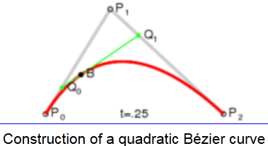
Quadratic Bézier curves
For quadratic Bézier curves one can construct intermediate points Q₀ and Q₁ such that as t varies from 0 to 1:
Point Q₀ varies from P₀ to P₁ and describes a linear Bézier curve.
Point Q₁ varies from P₁ to P₂ and describes a linear Bézier curve.
Point B(t) varies from Q₀ to Q₁ and describes a quadratic Bézier curve.

Slide 15
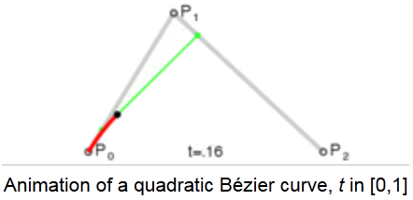
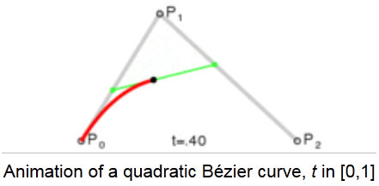
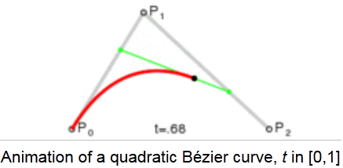
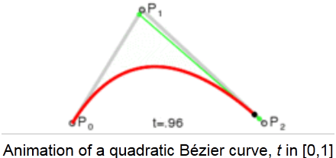
Quadratic Bézier curves

Slide 16
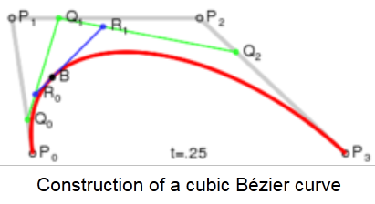
Cubic Bézier curve
For cubic curves one can construct intermediate points Q₀, Q₁, and Q₂ that describe linear Bézier curves, and points R₀ & R₁ that describe quadratic Bézier curves

Slide 17
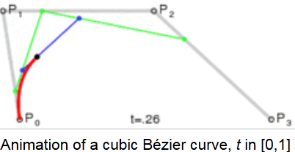
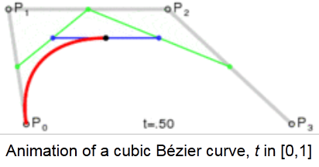
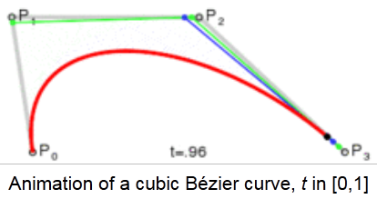
Cubic Bézier curve

Slide 18
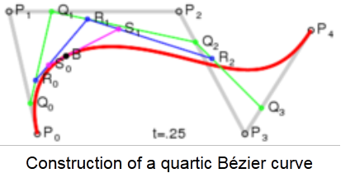
Higher-order curves
For fourth-order curves one can construct intermediate points Q₀, Q₁, Q₂ & Q₃ that describe linear Bézier curves, points R₀, R₁ & R₂ that describe quadratic Bézier curves, and points S₀ & S₁ that describe cubicBézier curves:

Slide 19
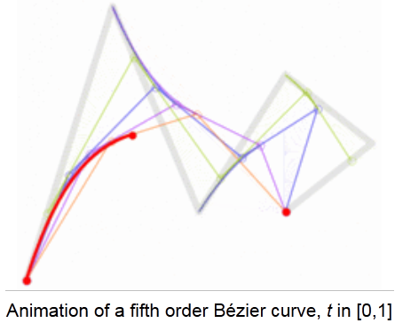
Higher-order curves
For fifth-order curves, one can construct similar intermediate points

